Slide 1

Chat with your Computer: A Fun Guide to Building a Virtual Desktop Assistant in Python!

Slide 2
Welcome to the Virtual Assistant World!
In this presentation, we'll learn how to build a virtual desktop assistant using Python. Get ready to chat with your computer and make your daily tasks more fun and efﬁcient.

Slide 3
Why Build a Virtual Desktop Assistant?
Discover the beneﬁts of having a virtual assistant. From automating repetitive tasks to providing instant information, a virtual assistant can enhance your productivity and bring joy to your daily routine.

Slide 4

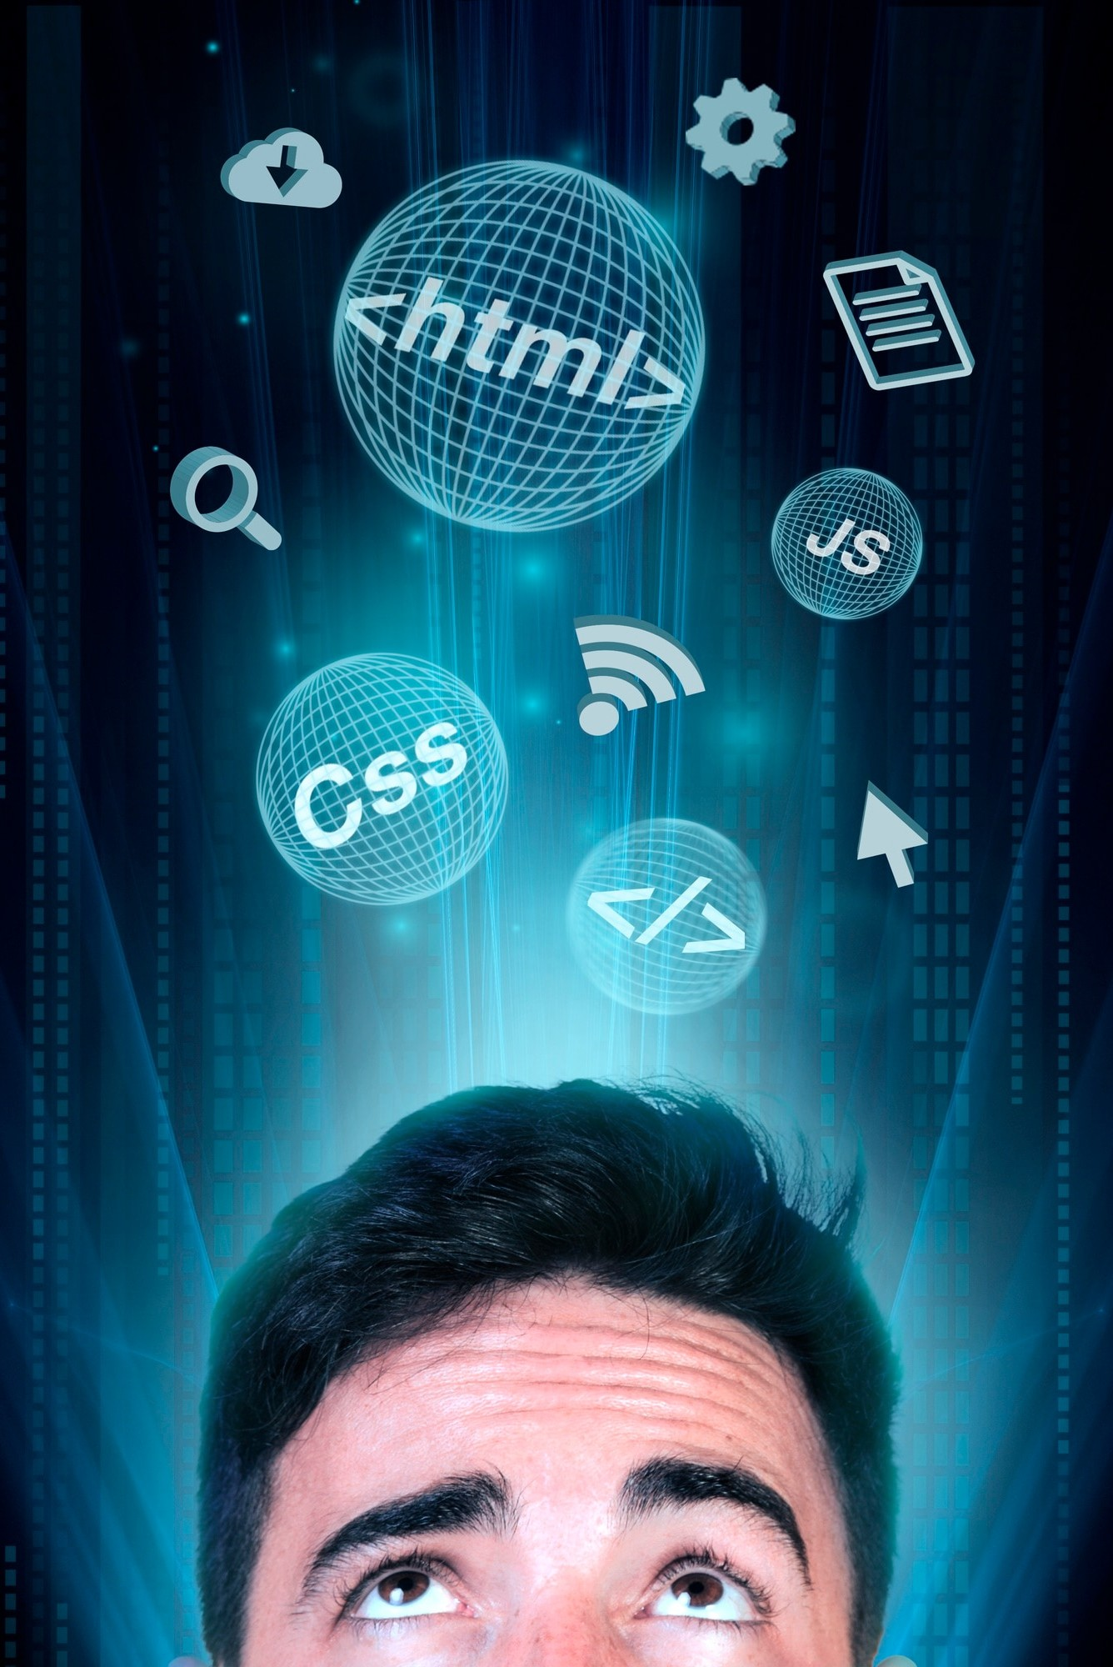
Getting Started with Python
Let's dive into the world of Python! We'll explore the basics of Python programming and how to use its powerful features to create our virtual desktop assistant.

Slide 5

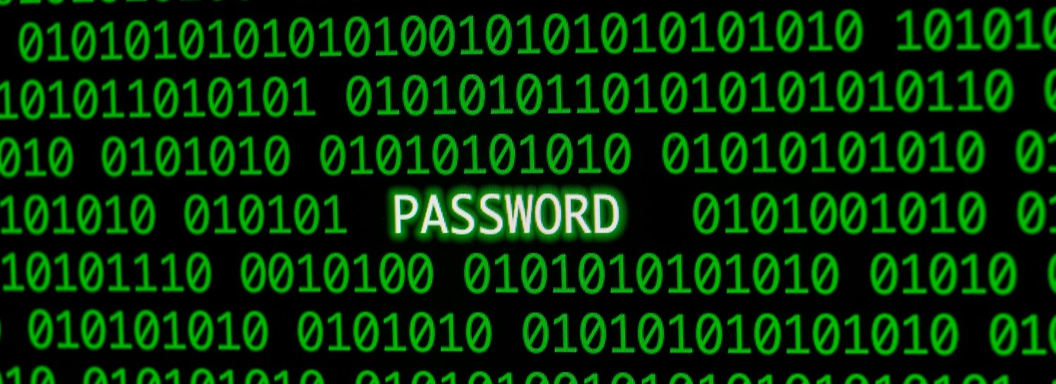
Understanding Natural Language Processing
Learn about the magic of NLP. We'll discuss how natural language processing enables our virtual assistant to understand and respond to human language, making interactions feel more natural and intuitive.

Slide 6
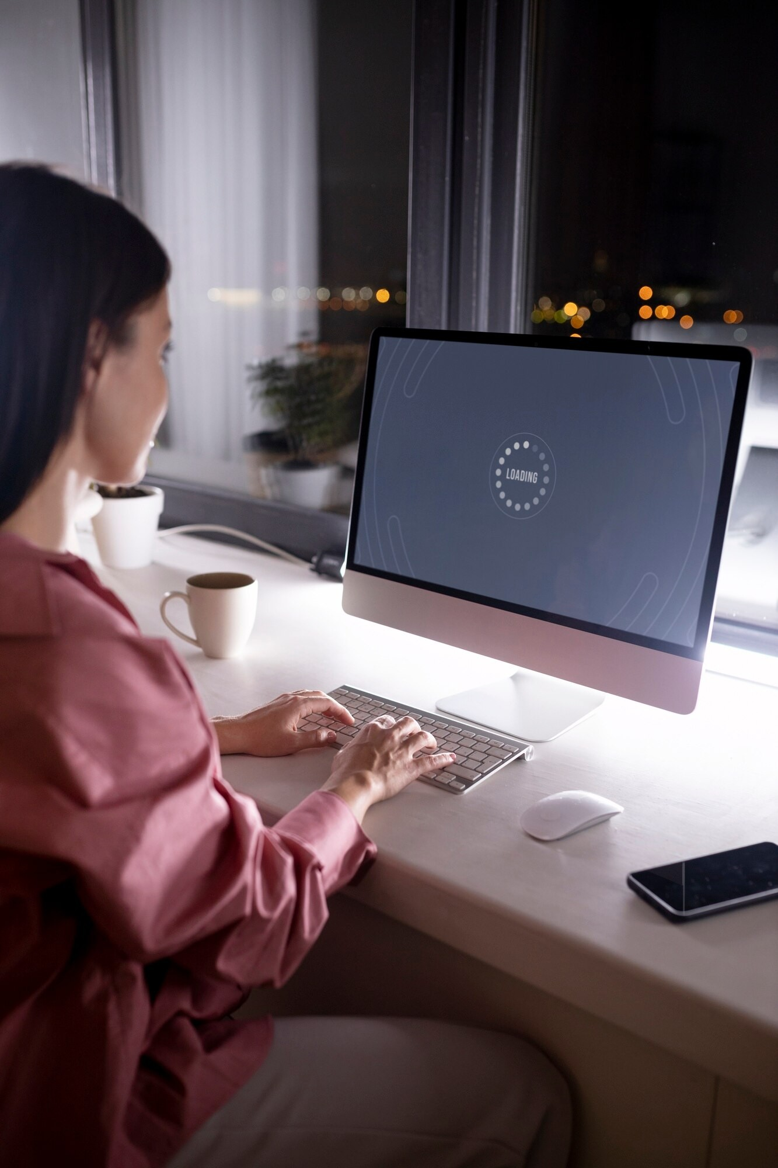
Designing the User Interface
Let's get creative! We'll explore the key elements of designing a user- friendly interface for our virtual assistant, making the interaction experience enjoyable and engaging.

Slide 7
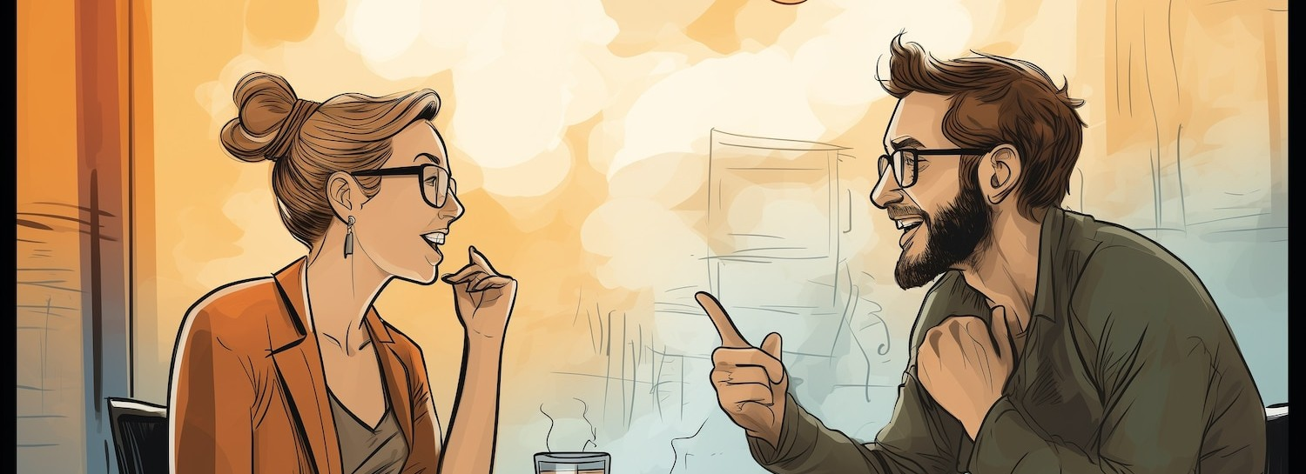
Building Conversational Skills
It's time to teach our virtual assistant to chat like a pro! We'll delve into the techniques for creating engaging and meaningful conversations, adding a touch of personality to our assistant.

Slide 8
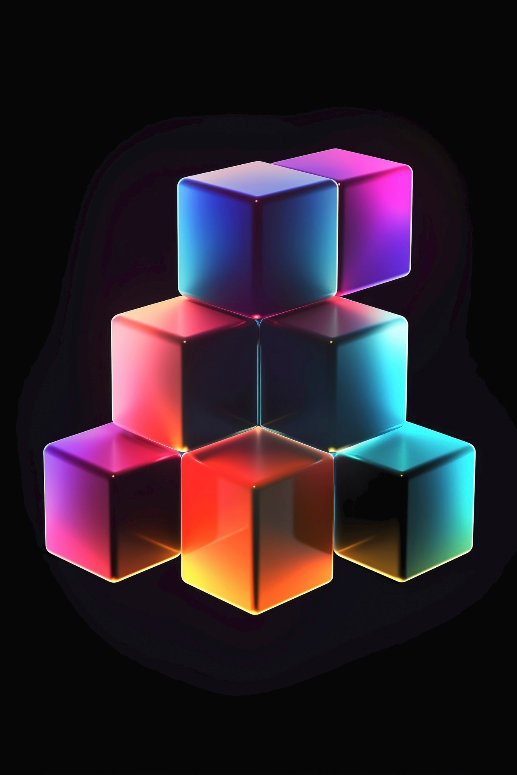
Adding Functionality with APIs
Unlock the power of APIs. We'll explore how to integrate various APIs to provide real-time information, perform tasks, and access external services, expanding the capabilities of our virtual assistant.

Slide 9

Testing and Debugging
Debugging is like solving a puzzle! We'll cover testing strategies and debugging techniques to ensure our virtual assistant functions smoothly and handles various scenarios with grace.

Slide 10


Deploying Your Virtual Assistant
It's showtime! We'll explore the options for deploying our virtual assistant, from running it on your local machine to hosting it in the cloud, making it accessible whenever you need a helping hand.

Slide 11
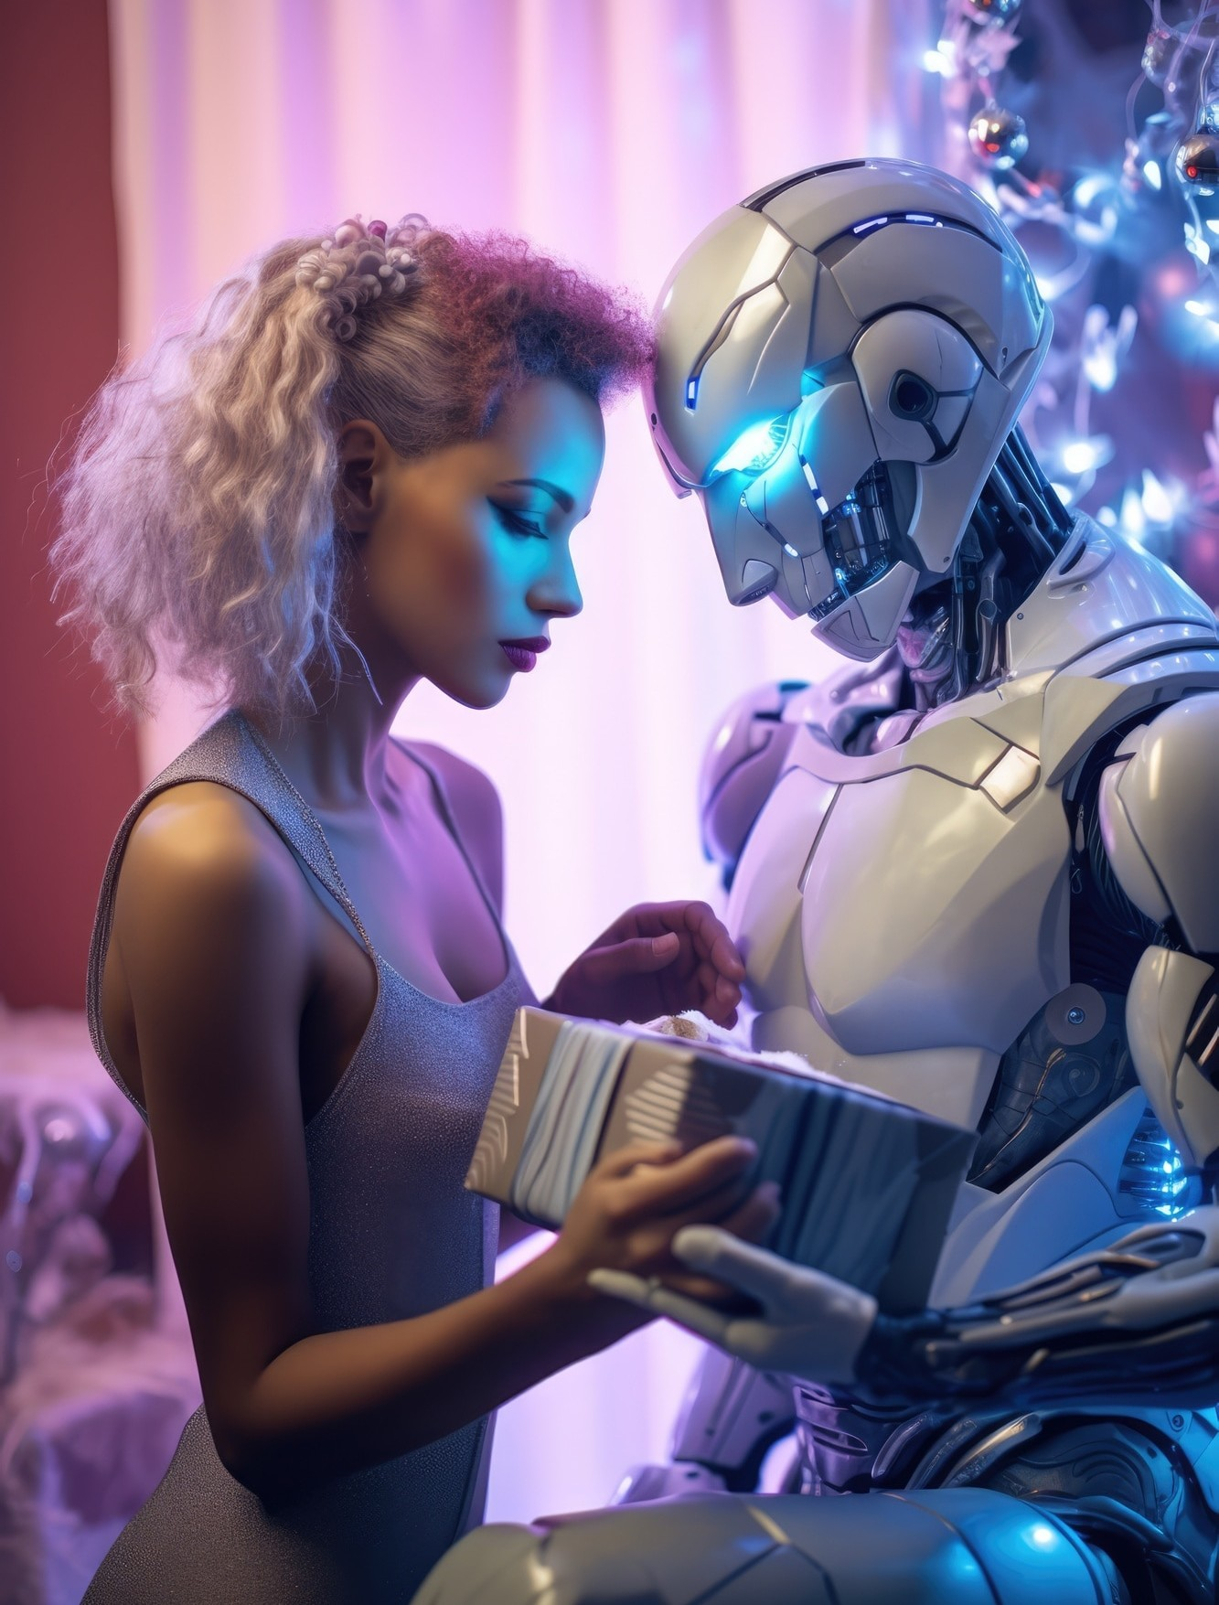
The Future of Virtual Assistants
Explore the exciting possibilities ahead! From advanced AI capabilities to personalized experiences, the future of virtual assistants is full of innovation and potential, promising to make our lives even more delightful.

Slide 12
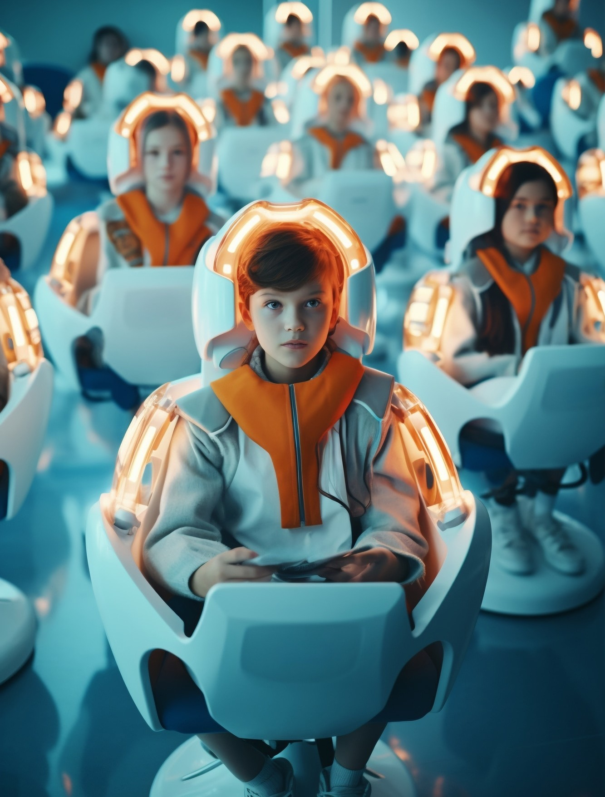
Join the Virtual Assistant Community
Connect with fellow enthusiasts! Join the vibrant community of virtual assistant creators and enthusiasts to share ideas, collaborate on projects, and stay updated on the latest trends in virtual assistant technology.

Slide 13

Embrace the Virtual Assistant Revolution!
Congratulations on embarking on this
exciting journey! With your newfound
knowledge, you're ready to create your very own virtual desktop assistant and add a touch of fun and efﬁciency to your daily life.

Slide 14

Thanks!

